Slide 1

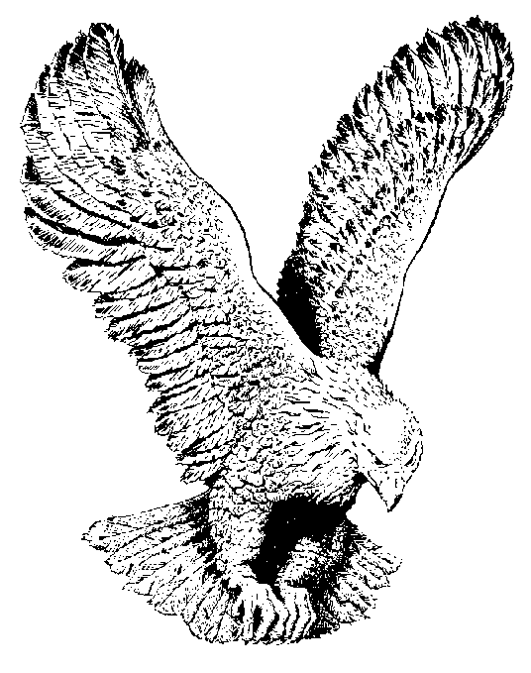
759 THE LION OF JUDAH
The Lion of Judah has broken every yoke (chain)
And given us the victory, again and again
The Lion of Judah has broken every yoke (chain)
And give us the victory, again and again.

